Slide 1

Logistic Regression

Slide 2
GUIDED BY
DR. VINOD SIR
PRESENTED BY
MR.SUMAN KUMAR MISS. ANUJA SALVI
MR. ROHIT CHANDRA MISS. ASHWINI TICHKULE
MR. ASHISH TIWARI

Slide 3
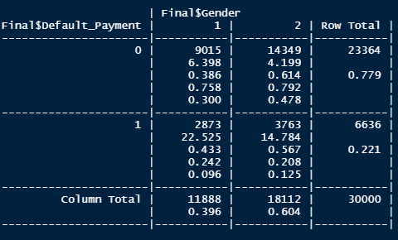
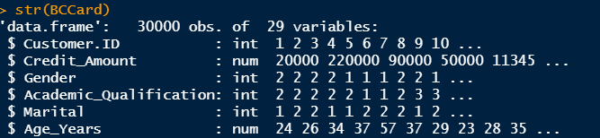
Introduction
We are working on classification model using logistic regression to predict the credibility of the customer, in order to minimize the risk and maximize the profit of German Credit Bank.
No of observations 30000 and 29 Variables
Convert int to factors
11 – Categorical , 14 – Numeric
39.63% Male and 60.37% Female
24.17% Males are defaulter
20.78% Females are defaulter
Should be factors

Slide 4
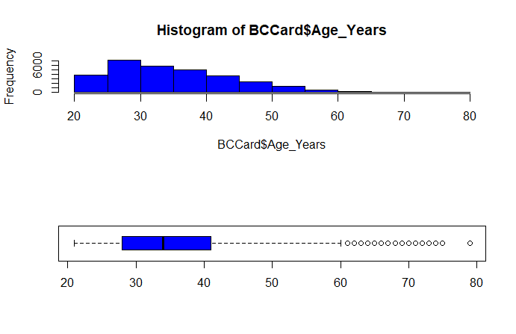
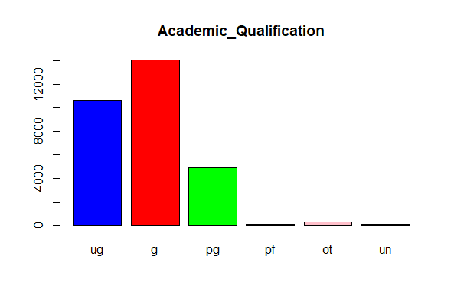
Dataset analysis and enrichment
describe(BankCreditCard)
str(BankCreditCard) -> variable description Table, Dim.

Slide 5
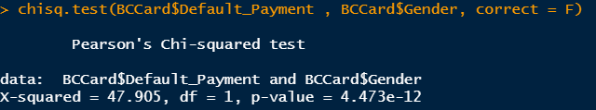
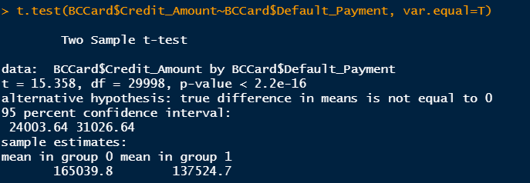
Hypothesis Testing and Predictor Selection
Chisq Test for two categorical variables and T Test continuous and categorical variables.

Slide 6
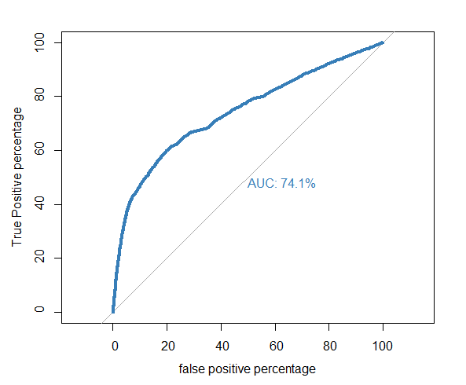
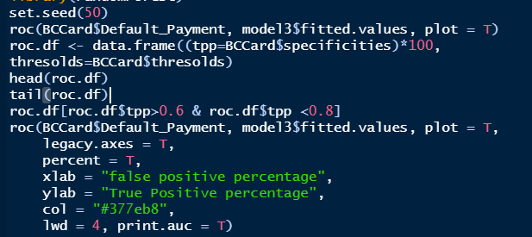
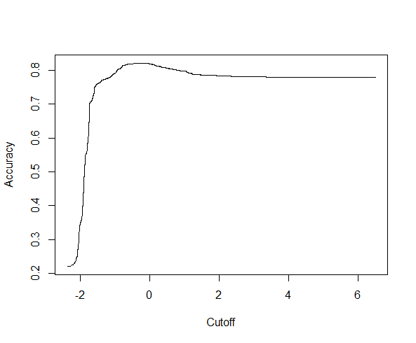
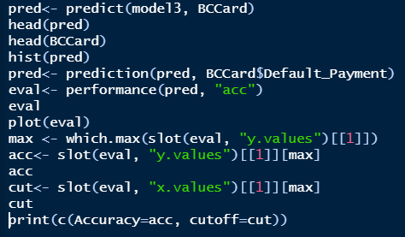
ROC, AUC and Accuracy Curve

Slide 7

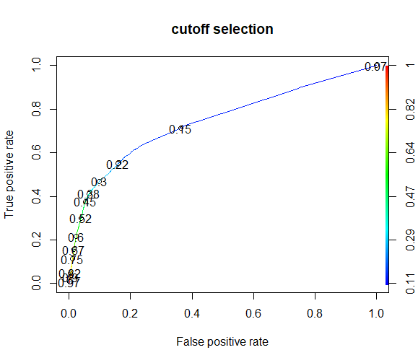
Cut-off Selection and Accuracy
SR.No | Cut-Off | Accuracy | True +ve | False +ve
1 | 0.22 | 0.7752 | 3668 | 3776
2 | 0.3 | 0.8068333 | 3108 | 2267
3 | 0.15 | 0.65 | 4723 | 8485
4 | 0.07 | 0.22 | 6636 | 23364
5 | 0.6 | 0.8194 | 2714 | 1495

Slide 8
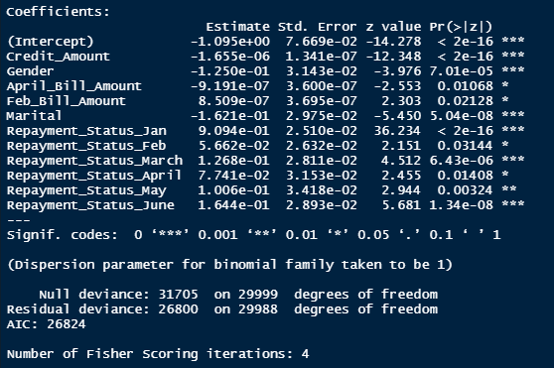
Model Selection
Model 1
model7<- glm(Default_Payment~Credit_Amount+Gender+April_Bill_Amount+Feb_Bill_Amount+Marital+
Repayment_Status_Jan+Repayment_Status_Feb+Repayment_Status_March+Repayment_Status_April+Repayment_Status_May+Repayment_Status_June, data = BankCreditCard, family = binomial)

Slide 9
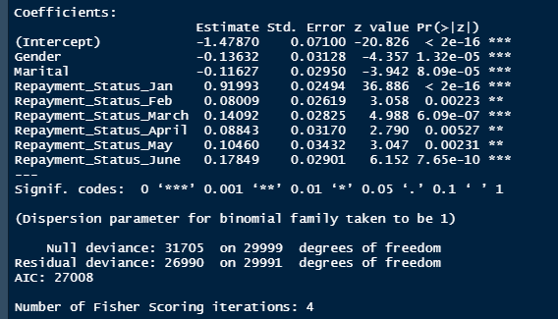
Model 2
model8<- glm(Default_Payment~Gender+Marital+Repayment_Status_Jan+Repayment_Status_Feb+Repayment_Status_March+Repayment_Status_April+Repayment_Status_May+Repayment_Status_June, data = BankCreditCard, family = binomial)

Slide 10
Thank you

